Slide 1
Introduction to Omeka
A. Bolintineanu

Slide 2
Learning Goals
By the end of this tutorial, participants will:
Understand the building blocks of Omeka as a content management system and data curation platform
Know how to navigate Omeka sites (private and public views)
Understand the basics of Dublin Core metadata schema
Be able to add items (individually), enable plugins, create collections, and build exhibits
Be able to manipulate the appearance of Omeka sites
Be able to create custom pages in Omeka

Slide 3

Omeka
Omeka = “Wordpress for museums”:
  Allows users to build digital archives of books, images, recordings, performances, and many other kinds of items
  Free
  Open-source
  Wide community uptake

Slide 4
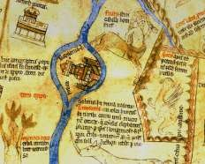


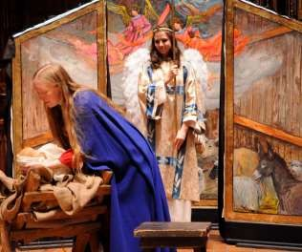
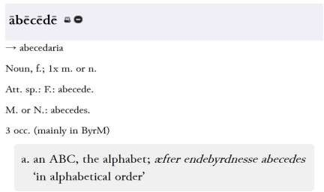
Items & Collections
Users can curate collections of digital items
Images
Audio
Videos
Performances
Lesson Plans

Slide 5
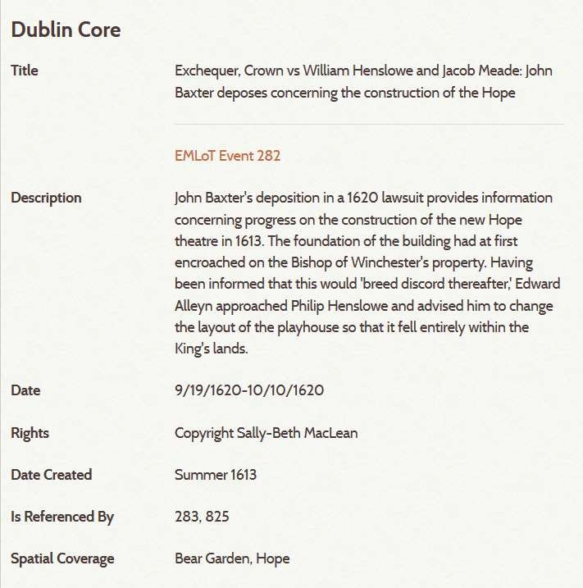
Metadata
Users can create rigorous metadata (Dublin Core standard) for each item
Discoverability & interoperability with aggregators and library catalogues

Slide 6
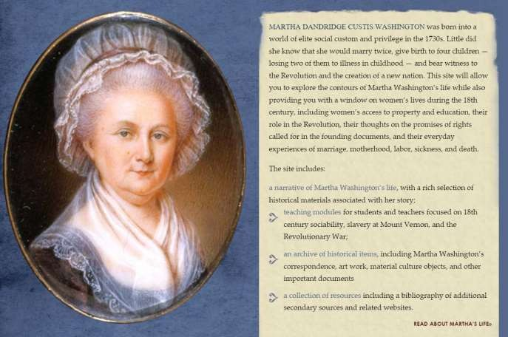
Storytelling
Through its Exhibit plugin, Omeka lets users tell stories with their collections.
Users can arrange items from their collections into multimedia essays, using the “Lego bricks” of the archive to tell stories and make arguments.

Slide 8
http://silveragecomics.uncc.edu/

Slide 9
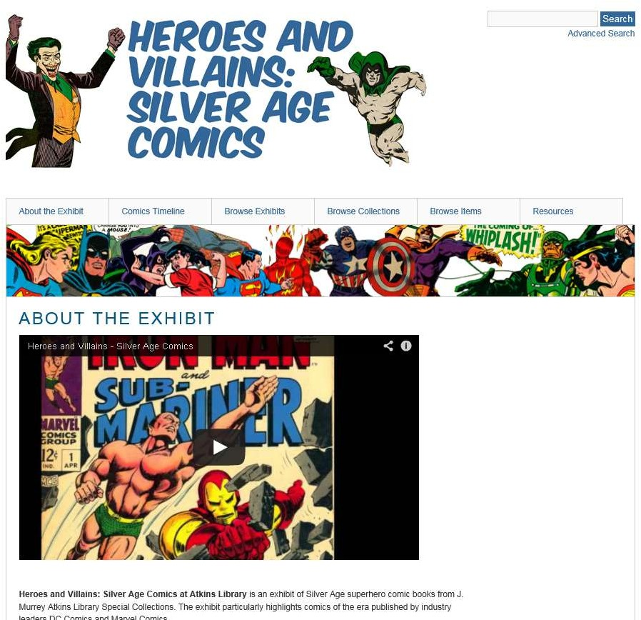
Heroes and Villains: Silver Age Comics
Heroes and Villains is a digital archive of Silver Age superhero comic books from J. Murrey Atkins Library Special Collections. Credits: Marc Bess, J. Murrey Atkins Library Digital Scholarship Lab, UNC Charlotte.

Slide 10
Omeka’s Building Blocks
Items (= content of Omeka)
Metadata (= information about information – Dublin Core metadata schema)
Collections (= a group of items; an item can be in only one collection at a time)
Exhibits (= a narrative woven around some items; an item can be in as many exhibits as desired)

Slide 11
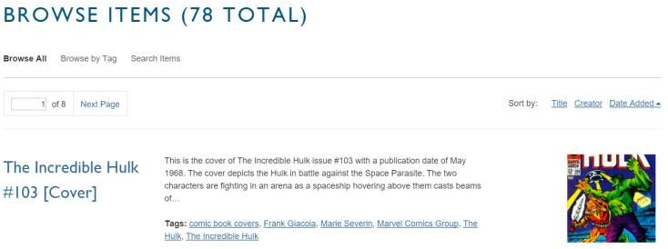
Items
Items are the building blocks of Omeka collections. They have metadata (Title, Description, Source, Date, etc.) and may have digital files attached.

Slide 12
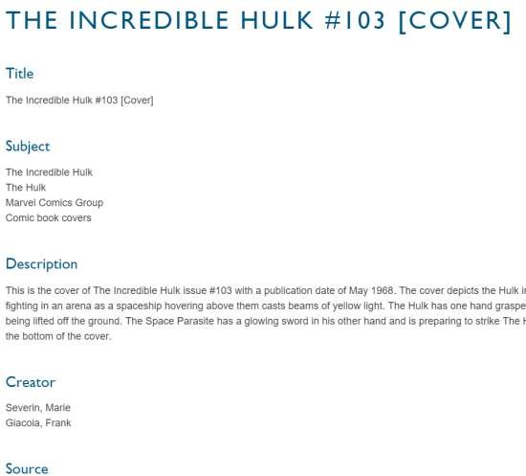
Metadata
Metadata is structured data about data.
For example, think about your library’s online catalogue: it contains the records of books, about which it tracks items of
information such as Author, Title, Publisher, Editor, Date.
The metadata schema that underlies Omeka is Dublin Core, a basic yet internationally accepted metadata schema.

Slide 13
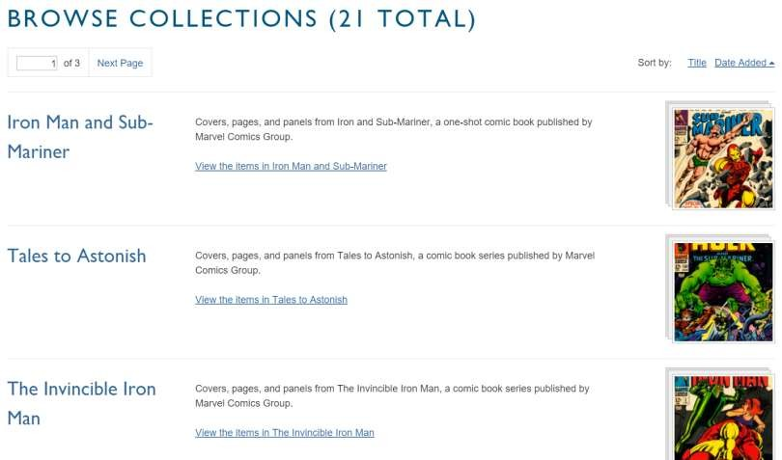
Collections
Collections are logical groupings or “folders” of Items. An item can be in only one Collection at a time.
Click on “Browse Collections”

Slide 14
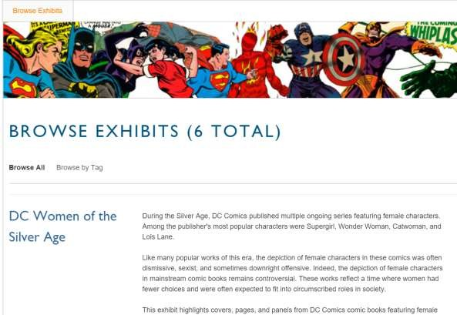
Exhibits
Exhibits are narratives woven around some items, telling their story and explaining their significance. An item can be in as many exhibits as you, the curator, desire.

Slide 15
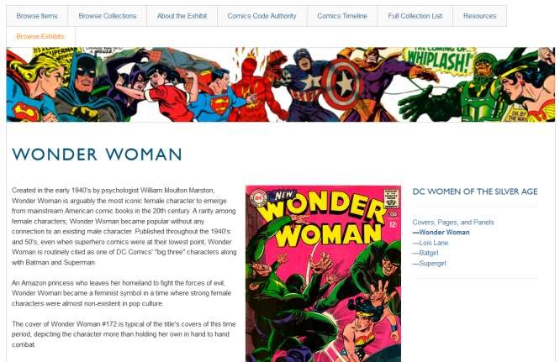
Heroes and Villains: Silver Age Comics
Exhibit: DC Women of the Silver Age. The exhibit is an Omeka Exhibit, a digital narrative showcasing a selection of Items from the collection. Note the exhibit’s structure on the left.

Slide 16
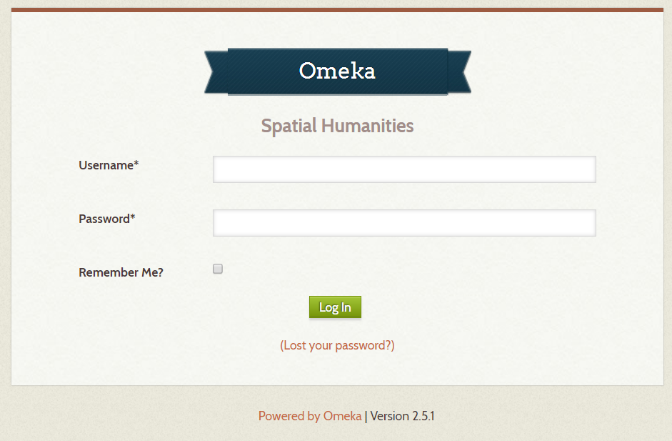
Get Started
Navigate to our course Omeka site:
https://spatial-humanities.library.utoronto.ca/admin/
Your user name is wdw235; your password is fall2018.

Slide 18
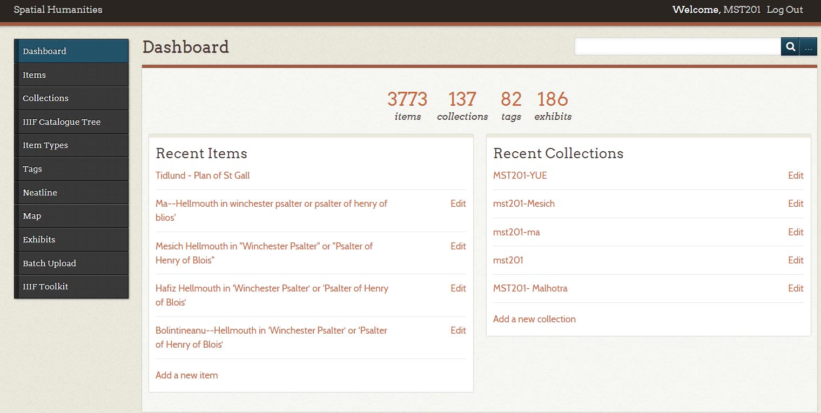
Welcome to Omeka’s Dashboard, the back-end access to the Omeka site. On the left, the options you need are: Items; Collections; and Exhibits.

Slide 19
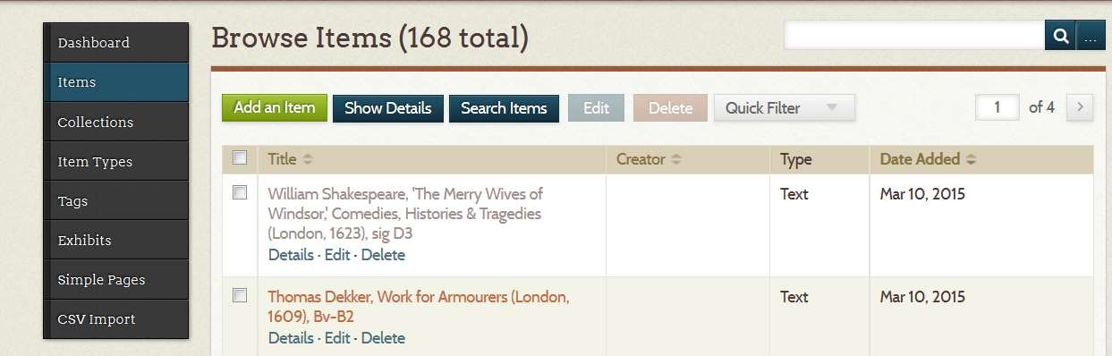
Add an item
Go to Dashboard and select “Items”
Select “Add an Item”
Fill in the metadata fields

Slide 20
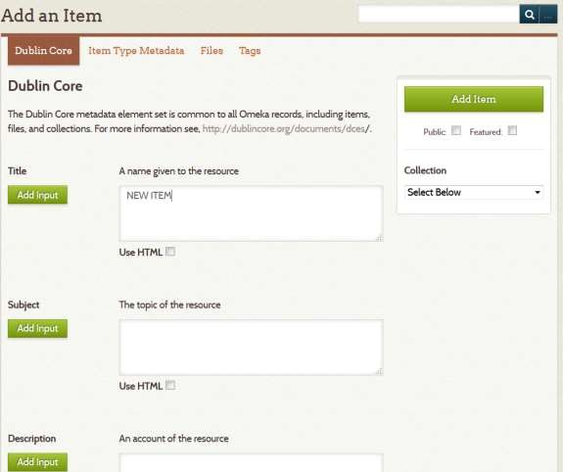
Add an item: Dublin Core Metadata
In the Item’s fields, enter the metadata: Title, Subject, Description, etc. Before you add items to your collection, you will have figured out how the Dublin Core metadata schema applies to your particular data: consistency across your collection is key.
For example, for medieval manuscripts, you can list authors of the texts under Author: but what of known scribes, who may have also intervened in the text? Are they Authors or Publishers or Contributors? Pick what makes sense and apply it consistently.
For details on Dublin Core :
http://dublincore.org/documents/dces/
If you wish the Item to be visible on the public view of the site, check “Public” (under “Add Item”).
Click “Add Item” (green, right).

Slide 21
Add an item: Dublin Core Metadata
In this assignment, you are responsible for the following fields (and some may have to stay blank):
Title;
Description (a paragraph recording your description of the object, in your own words: 100-200 words)
Creator;
Source (can be e.g. manuscript or book or collection);
Publisher;
Date;
Rights (i.e. who owns copyright – language here will vary strongly depending on institution the items come from, and that is not an error on the students’ part);
Format material, e.g. bronze, parchment, etc.);
Language;
Coverage (place where the object is from/was made).

Slide 22
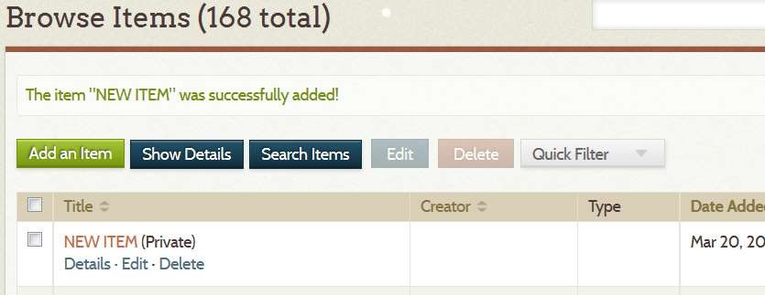
Add an Item: Success
Success: our trial item (“New Item”) was created and added to the digital collection!

Slide 23
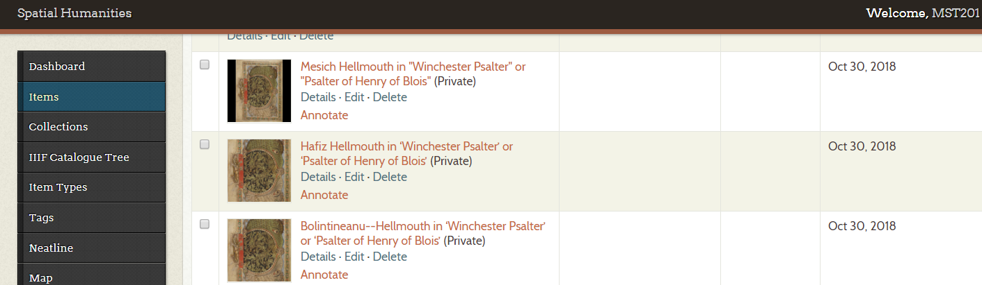
Add an Image to the Item
Go to the Items and select the “Edit” option under your Item

Slide 24
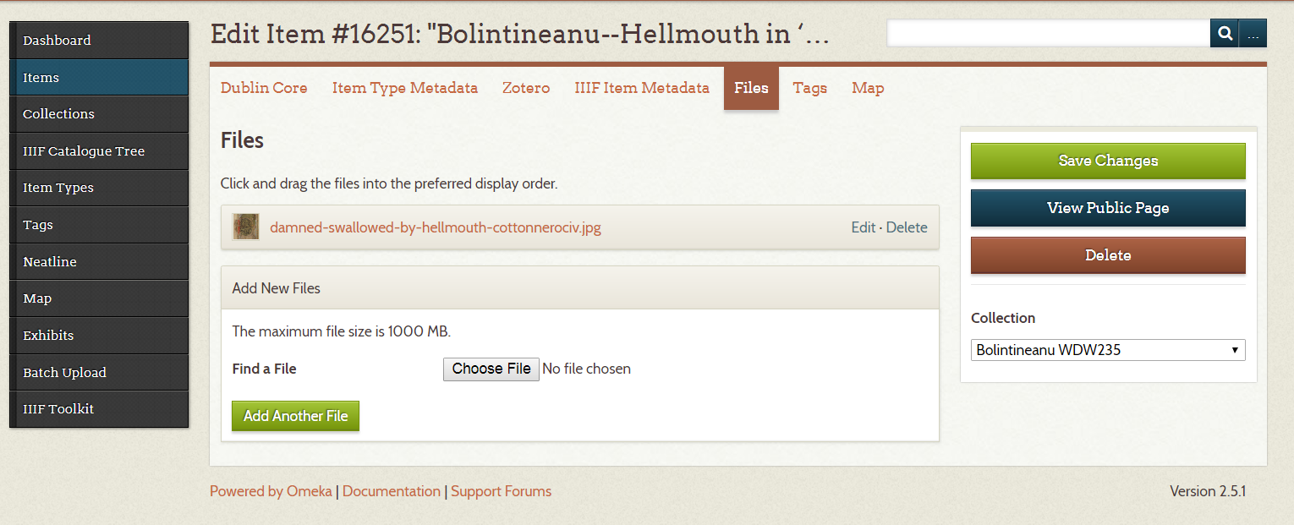
From the top horizontal row of options of the Item: select Files→ Choose File
Upload your image
Save changes

Slide 25
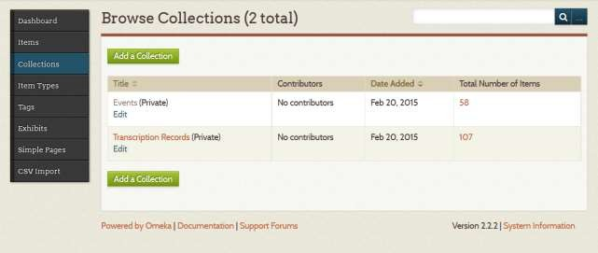
Omeka’s Building Blocks: Collections
Collections are logical groupings or “folders” of Items. An item can be in only one Collection at a time.
Go to Dashboard and select “Collections”
Select “Add a Collection”
Fill in the metadata elements as desired, as for Item. (Everything in Omeka has metadata: it is turtles all the way down.)

Slide 26
Omeka’s Building Blocks: Collections
Collections are logical groupings or “folders” of Items. An item can be in only one Collection at a time.
Go to Dashboard and select “Collections”
Select “Add a Collection”
Fill in the metadata elements, as for Item.
Please use WDW235 – Your Last Name as your Collection title.

Slide 27
Add an Exhibit: Plan
The Exhibit is a narrative pathway through the collection; or, if you will, a digital essay based on the items in your collection.
First write the prose for your exhibit and decide what items need to appear in it.
To look pretty in the Exhibit, the items need to have picture or video files attached.
Save your prose in a separate file.
Put your immortal prose somewhere safe. Omeka Exhibits cannot be exported automatically: and if you ever delete yours in error, there is no getting it back.

Slide 28
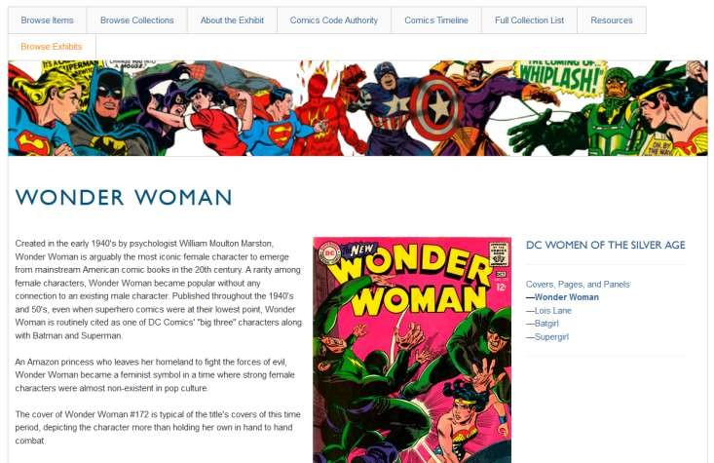
Add an Exhibit: Structure
An Omeka Exhibit has:
  An overview page: displays an abstract (summary) of your exhibit
  Pages: sections of your exhibit; these display text as well as items (remember, to look pretty, the items need to have files attached)
  In each Page: blocks
  Pages are about content; Blocks are about layout/format
You get to decide the content and layout of your pages.

Slide 29
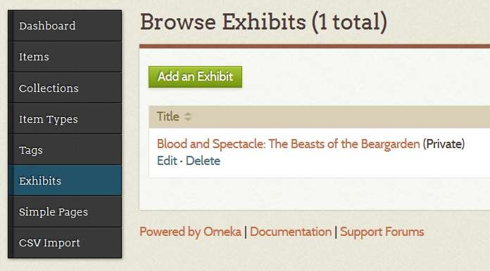
Add an Exhibit: Creation
Go to the Dashboard and click on Exhibits.
Click Add an Exhibit.

Slide 30
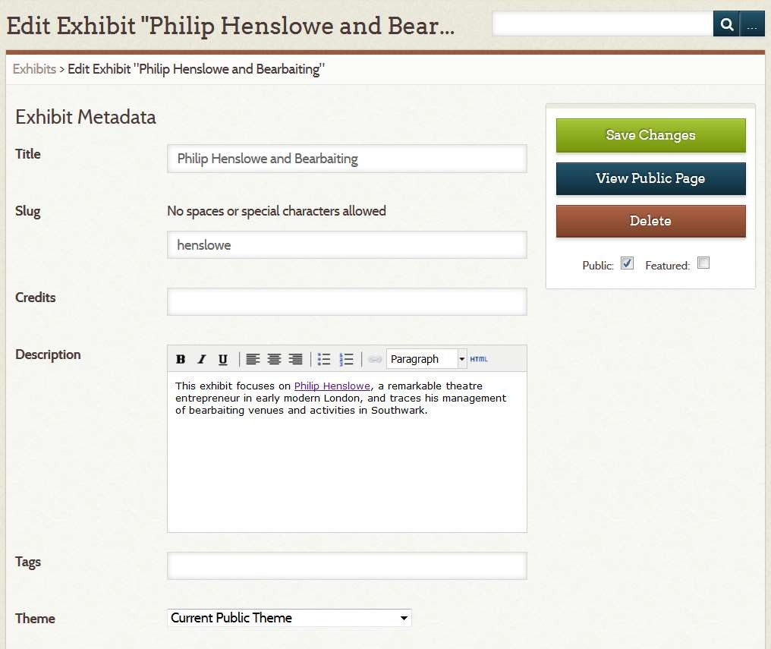
Add an Exhibit: Metadata
Every Exhibit has metadata.
Title displays as the Exhibits title.
Slug forms the URL.
Description is an abstract of the Exhibit that appears on its first page.

Slide 31
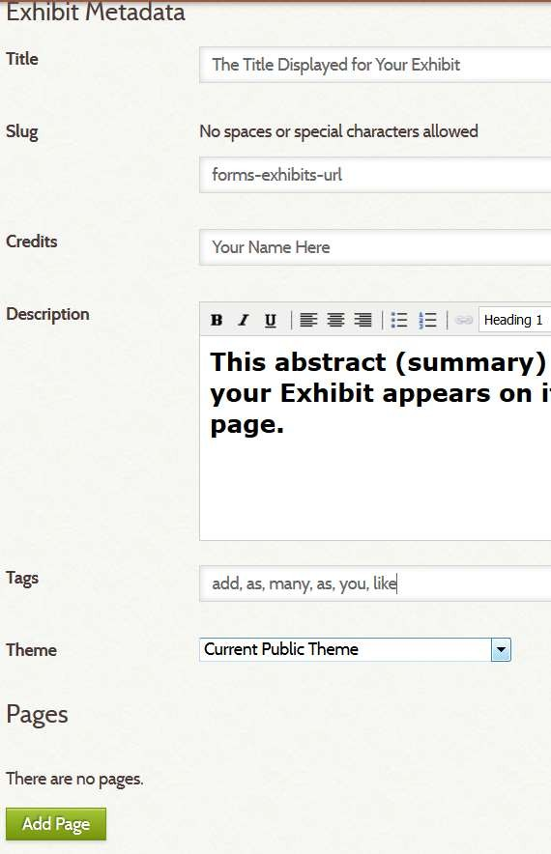
Add an Exhibit: Structure
The Exhibit consists of Pages.
Each Page is a section of your Exhibit.
To build your Exhibit, start adding Pages by clicking the Add Page green button.

Slide 32
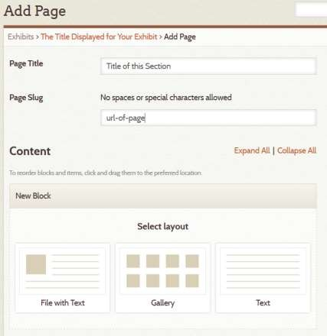
Add an Exhibit: Pages
Each Page may consist of multiple blocks:
  Text and an item block
  A gallery of items block
  Text block
To create a new Block, click on the desired layout. This block will be added as a section of this page. Your page can contain as many blocks as you like; you can drag them around to rearrange them.

Slide 33
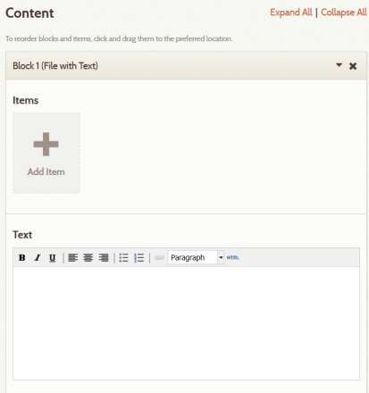
Add an Exhibit: Blocks
Once you add a block, enter your narrative in the window labelled Text.
Then click on the Add Item button to add items that illustrate your narrative.

Slide 34
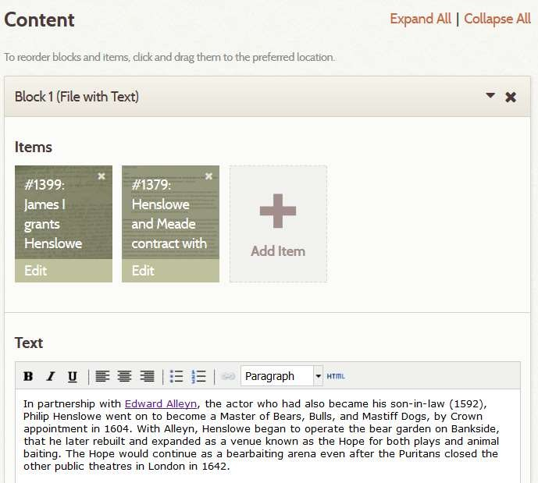
Add an Exhibit: Blocks
Once you have added your narrative and selected your Items, your block will look like this:
To see what the Page actually looks like, select the View Publi Page button (right side of browser, in line with Content).
c

Slide 35
Add an Exhibit: Overall Design
In your finished Exhibit, each Page will be a Section of the Narrative, illustrated with Items from your digital collection.
You can use and reuse items from your collection in as many Exhibits as you wish.

Slide 36
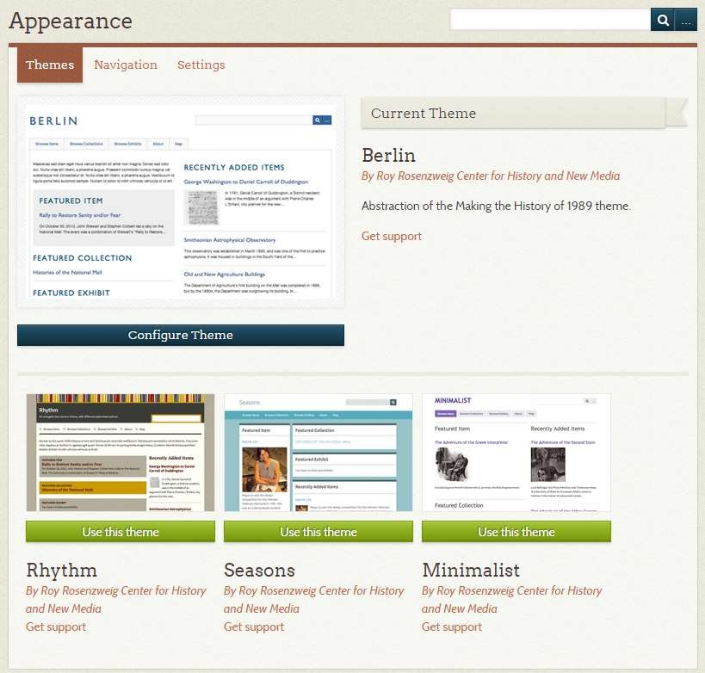
Appearance
You can customize the appearance of your Omeka site by configuring its theme (i.e. colours, fonts, and layout of the site, or even of an individual exhibit) and adding a logo image.

Slide 37
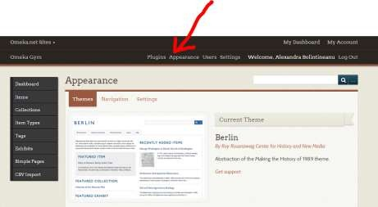
Appearance
To configure the theme and add a header image to your Omeka site, first find or create that image.
Go to Dashboard
From the horizontal top menu, select Appearance

Slide 38

Appearance
Choose from the themes available. Your choice of theme will determine the fonts, colour scheme, and layout of your site (or of your exhibit).

Slide 39
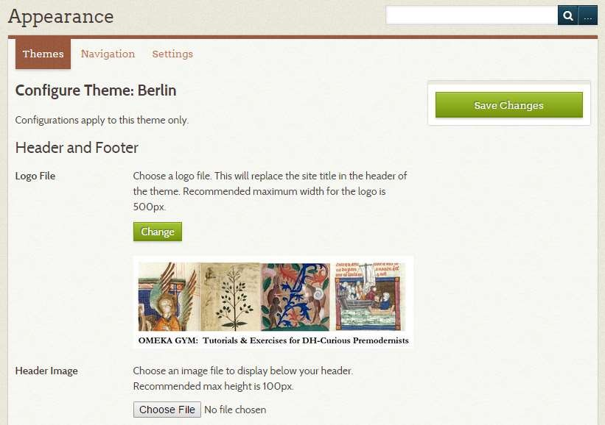
Appearance
To configure your theme or add a logo for your site, select “Configure Theme.”
Then add a logo or header image, paying attention to file size restrictions.
Save changes.

Slide 40
Building an Omeka Site: Conclusions
Make a project plan with deadlines. But allow for disasters.
Plan your exhibits (possibly on paper) well ahead of time
Draft and save your Item descriptions and your Exhibit content in word processing software; save this draft;
Paste your content from Word into Omeka.

